Slide 1

Tech Titans
Analysis of Crime and school ratings influence of home prices

Slide 2
Project Description/Outline
Buying a home in Atlanta has become more cumbersome over the last couple of years.
While there are many factors that are more individualized in finding a potential buyer’s “prefect choice”, there are a few factors that many will agree are almost universal.
Two of those factors are crime rates and the quality of local schools.

Slide 3
Questions to answer
What is the correlation between crime rates and housing prices?
What is the correlation between high school ratings and housing prices?
Do these factors have any connection to each other?
Will you see areas in Atlanta where both crime rates and high school ratings are high or low?
Are there any interesting areas found from the data?
Is there any areas of recommendation for the home buyer to be aware of based on the data?

Slide 4
Coverage
City of Atlanta zip codes (not metro)
<<<Atlanta map>>>

Slide 6
Data
<<<list of data sources and how cleaned>>>

Slide 7
School criteria
There are several criteria that can be used to evaluate school districts, including:
Student achievement: This can be measured by standardized test scores, graduation rates, and college attendance rates.
Teacher quality: This can be measured by the number of highly qualified teachers, teacher turnover rates, and teacher-to-student ratios.
Resources: This can include factors such as funding per student, class size, and access to technology and extracurricular activities.
Safety and discipline: This can include measures such as crime and violence rates, bullying, and truancy.
Parent and community involvement: This can include measures of parental participation in school activities and the level of community support for the schools.
Parent/Student Surveys on Overall Experience:
College readiness: This can include measures such as the number of AP classes offered, and the number of students who passed AP exams.
Diversity and inclusion: This can include measures such as the percentage of students from diverse backgrounds and the policies and programs in place to support them.
Special needs support: This can include measures such as the number of students with special needs and the resources provided to support them.

Slide 8
Analysis and Conclusion

Slide 9
Tech Requirements
Network
Satellite
Link

Slide 10

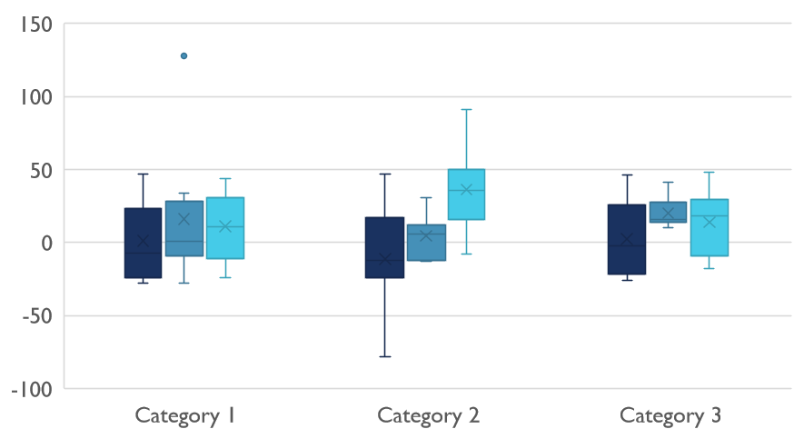
Competitive Landscape

Slide 11

Digital Communications
Cloud
Local
Hybrid

Slide 12

Thank You
someone@example.com

